Slide 1
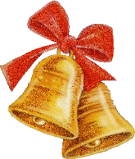
HOW WELL DO YOU KNOW Santa claus?

Slide 2
Where is Santa from?
The UK
The North Pole
The USA

Slide 3
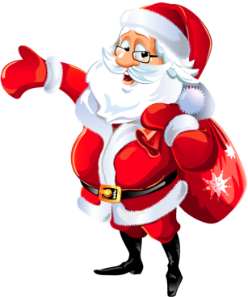
Where is Santa from?
The UK
The North Pole
The USA

Slide 4
2. What colour is his costume?
It’s green.
It’s white.
It’s red.

Slide 5
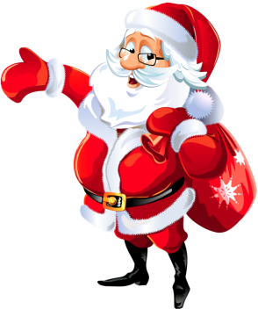
2. What colour is his costume?
It’s green.
It’s white.
It’s red.

Slide 6
3. What colour are his boots and his belt?
Black
Red
Broan

Slide 7
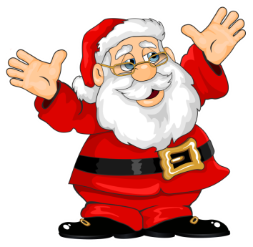
3. What colour are his boots and his belt?
Black
Red
Broan

Slide 8
4. What is he like?
Old and sad.
Plump and jolly.
Thin and greedy.

Slide 9
4. What is he like?
Old and sad.
Plump and jolly.
Thin and greedy.

Slide 10
5. What colour is his beard?
Black
Grey
White

Slide 11
5. What colour is his beard?
Black
Grey
White

Slide 12
6. How does he get into the house?
Through the window.
Through the chimney.
Through the door.

Slide 13
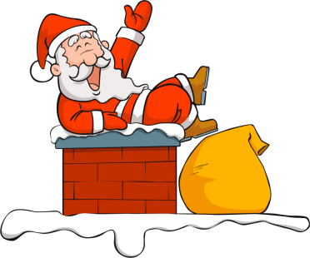
6. How does he get into the house?
Through the window.
Through the chimney.
Through the door.

Slide 14
7. How does he go from house to house?
On a sleigh.
On a horse.
By car.

Slide 15
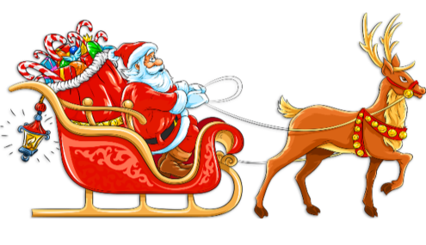
7. How does he go from house to house?
On a sleigh.
On a horse.
By car.

Slide 16
8. How many horses pull his sleigh?
Three
Six
Nine

Slide 17
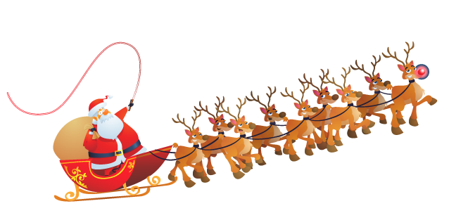
8. How many horses pull his sleigh?
Three
Six
Nine

Slide 18
9.What is the name of the most famous reindeer?
Blitzen
Rudolf
Vixen

Slide 19
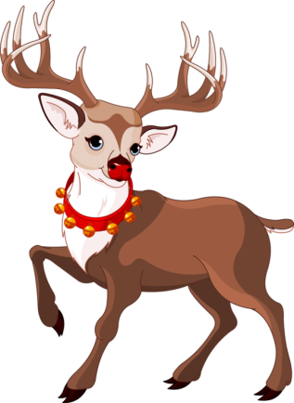
9.What is the name of the most famous reindeer?
Blitzen
Rudolf
Vixen

Slide 20
10.What colour is Rudolf’s nose?
White
Brown
Red

Slide 21
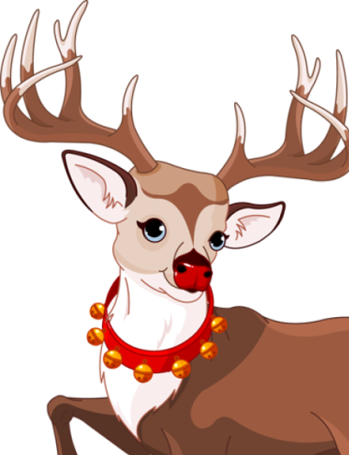
10.What colour is Rudolf’s nose?
White
Brown
Red

Slide 22
11.What are Santa’s reindeer’s favourite sweets?
Cabbage
Carrots and sugar cubes
Potatoes

Slide 23
11.What are Santa’s reindeer’s favourite sweets?
Cabbage
Carrots and sugar cubes
Potatoes

Slide 24
12.What does Santa like eating?
Chocolate
Cookies
soup

Slide 25
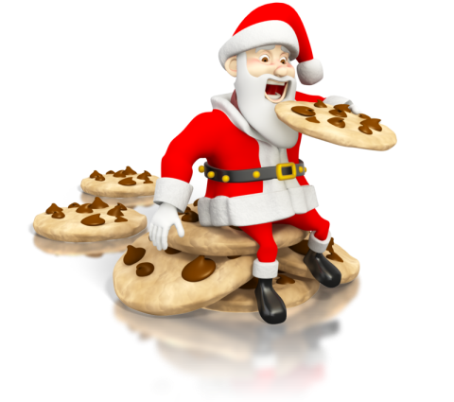
12.What does Santa like eating?
Chocolate
Cookies
soup

Slide 26
13.Who are Santa’s helpers?
Ghosts
Fairies
Elves

Slide 27
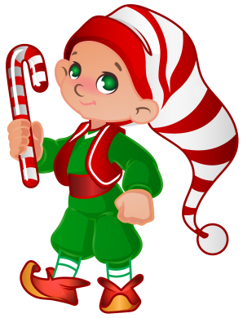
13.Who are Santa’s helpers?
Ghosts
Fairies
Elves

Slide 28
14.What do most elves wear on the tip of their shoes?
Bells
Holly
Stars

Slide 29
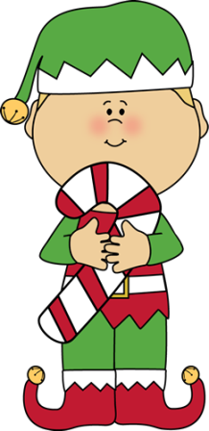
14.What do most elves wear on the tip of their shoes?
Bells
Holly
Stars

Slide 30
15. How many times does Santa Claus check his list?
Once
Twice
Three times

Slide 31
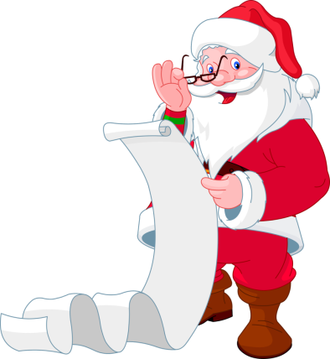
15. How many times does Santa Claus check his list?
Once
Twice
Three times

Slide 32
16. Where does he carry the toys?
In his pocket
In a box
In a sack

Slide 33
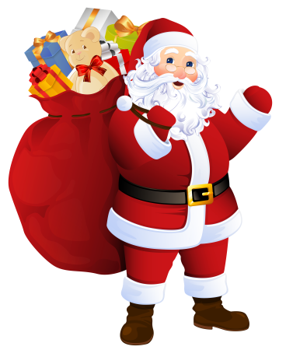
16. Where does he carry the toys?
In his pocket
In a box
In a sack

Slide 34
17. When does he deliver his gifts?
On Christmas Eve
On Christmas Day
On Boxing Day

Slide 35
17. When does he deliver his gifts?
On Christmas Eve
On Christmas Day
On Boxing Day

Slide 36
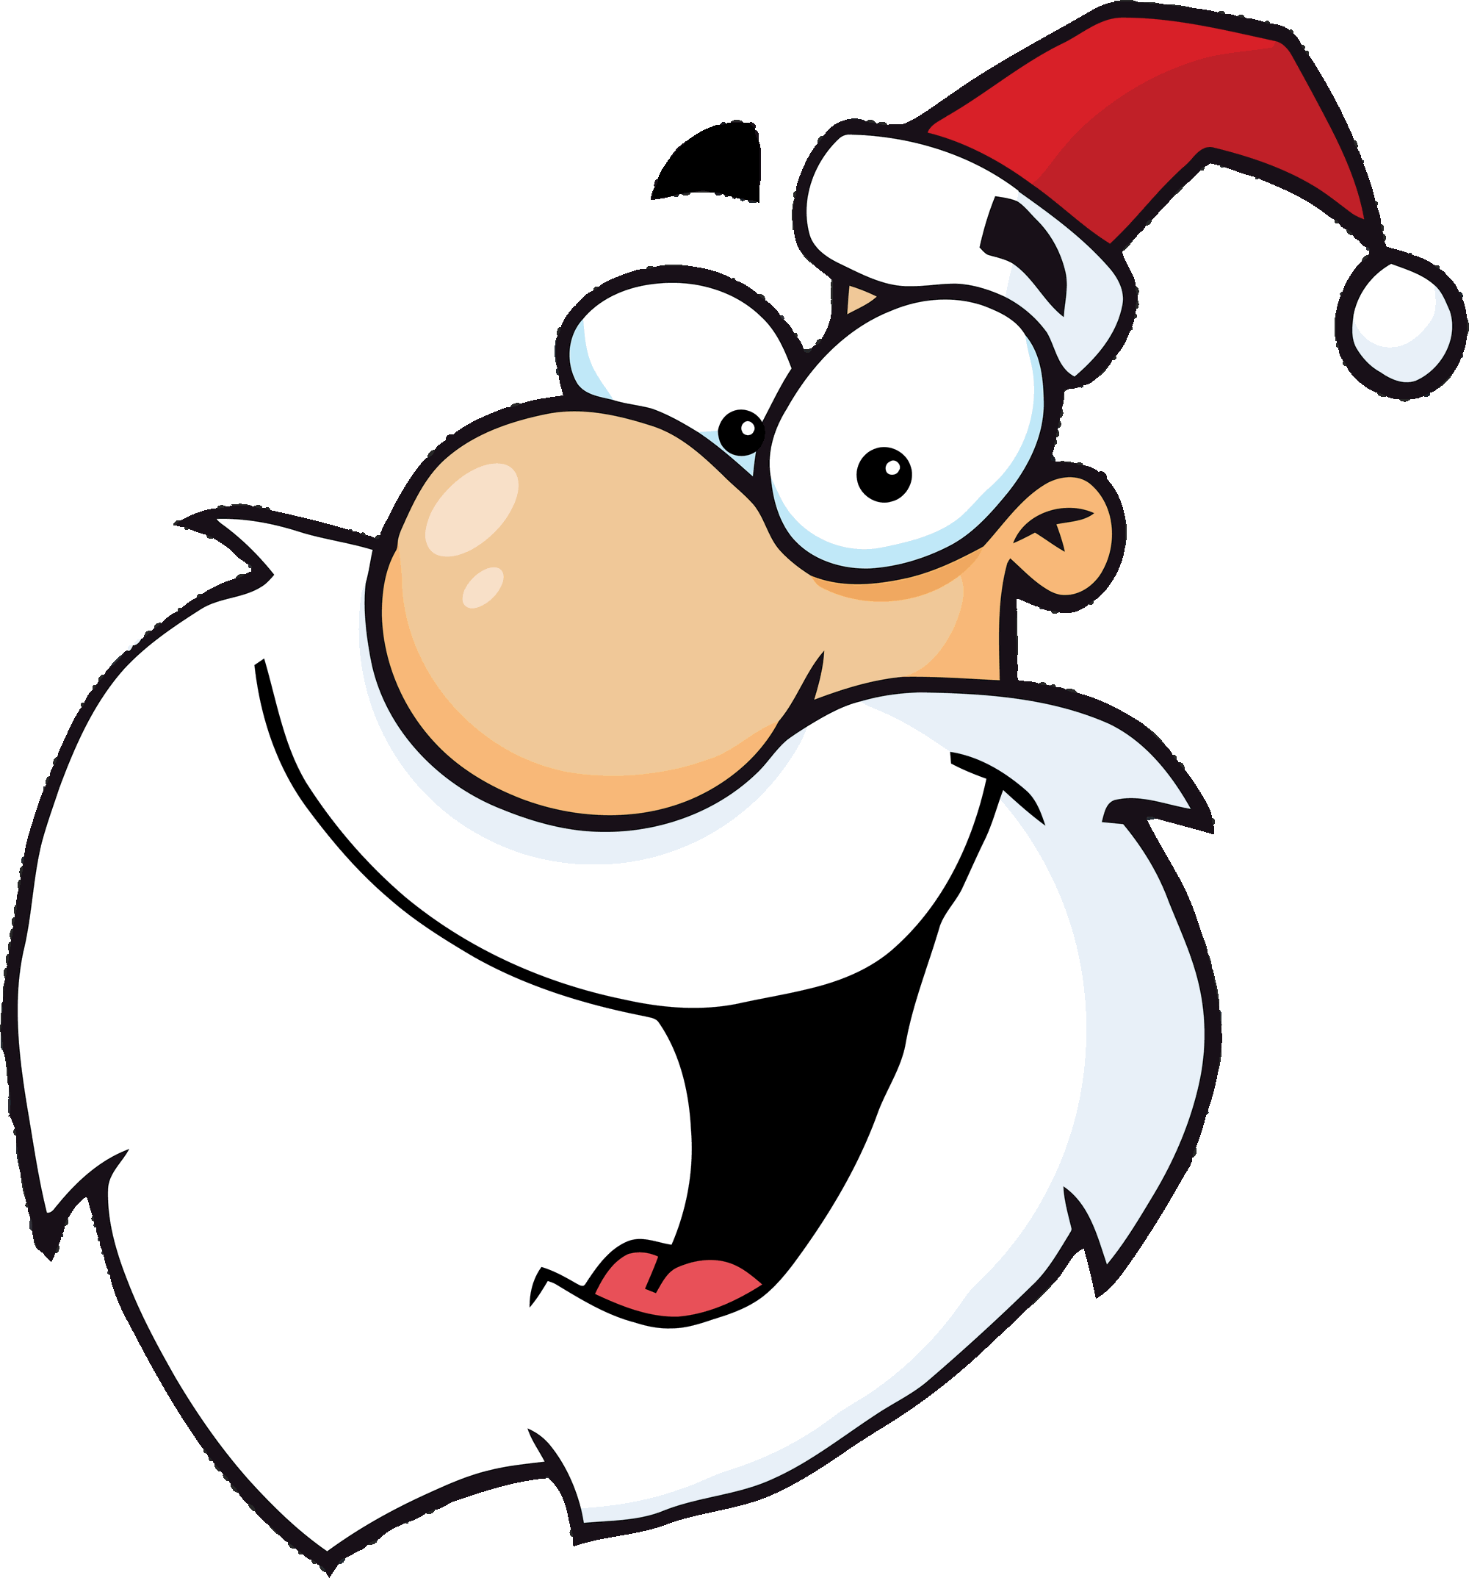
Listen and read

Slide 37
You will be listening to a text.
Which word is missing in its heading?
Scientists find a bone from ______

Slide 38
Scientists find a bone from Santa Claus
Yesterday I read that scientists had found a bone from Santa Claus.
Ask 3 questions about the bone.

Slide 39
listen

Slide 40
Scientists from Oxford University in the UK believe they have found a bone that belonged to Santa Claus. The real name of Santa Claus is St Nicholas. He was a Christian holy man who lived in the 4th century in what is now Turkey. He died in the year 343. There are stories that he created many miracles, which is why the Christian church made him a saint. The scientists said the bone is from when St Nicholas lived. An archaeologist said: "This bone…suggests that we could possibly be looking at remains from St Nicholas himself." St Nicholas is the saint of children and students. There are stories that he secretly gave presents to poor people. This is the story behind today's Santa Claus.

Slide 41
Santa Claus has other names. His name can be shortened to Santa. In many countries, he is called Father Christmas. He is a legendary character who brings presents to the homes of well-behaved children on the evening of the 24th of December (Christmas Eve). Badly-behaved children get a piece of coal. He delivers the presents on a sleigh, which is pulled through the air by his flying reindeer. Santa Claus is usually seen as an over-weight, happy, smiling man with a white beard. He wears a red coat with a white fur collar and cuffs, red trousers, a black leather belt and black boots. He lives in the North Pole, where he has a toy-making workshop. Children today can track his Christmas Eve journey online.

Slide 42
read

Slide 43
Scientists from Oxford University in the UK believe they have found a bone that belonged to Santa Claus. The real name of Santa Claus is St Nicholas. He was a Christian holy man who lived in the 4th century in what is now Turkey. He died in the year 343. There are stories that he created many miracles, which is why the Christian church made him a saint. The scientists said the bone is from when St Nicholas lived. An archaeologist said: "This bone…suggests that we could possibly be looking at remains from St Nicholas himself." St Nicholas is the saint of children and students. There are stories that he secretly gave presents to poor people. This is the story behind today's Santa Claus.

Slide 44
Santa Claus has other names. His name can be shortened to Santa. In many countries, he is called Father Christmas. He is a legendary character who brings presents to the homes of well-behaved children on the evening of the 24th of December (Christmas Eve). Badly-behaved children get a piece of coal. He delivers the presents on a sleigh, which is pulled through the air by his flying reindeer. Santa Claus is usually seen as an over-weight, happy, smiling man with a white beard. He wears a red coat with a white fur collar and cuffs, red trousers, a black leather belt and black boots. He lives in the North Pole, where he has a toy-making workshop. Children today can track his Christmas Eve journey online.

Slide 45
Ask and answer

Slide 46
1. of think you do What Claus Santa?
1. What do you think of Santa Claus?
2. parents Santa make Claus children believe Should in?
2. Should parents make children believe in Santa Claus?

Slide 47
3. is big How news this?
3. How big is this news?
4. secret Have given a ever received present you or?
4. Have you ever given or received a secret present?

Slide 48
5. do What 'bone' word the hear you when of think you?
5. What do you think of when you hear the word ‘bone’?
6. Christmas Santa is – Father name or better Claus the Which?
6. Which is the better name – Santa Claus or Father Christmas?

Slide 49
7. of the clothes that Santa wears What do you think?
7. What do you think of the clothes that Santa wears?
8. workshop Would you like to visit Santa's toy - making?
8. Would you like to visit Santa’s toy-making workshop?

Slide 50
9. would to Claus questions like Santa What you ask?
9. What questions would you like to ask Santa Claus?
10. Were child behaved - well a you?
10. Were you a well-behaved child?

Slide 51
Compare and contrast

Slide 52
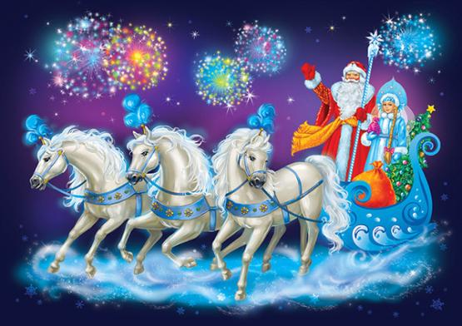
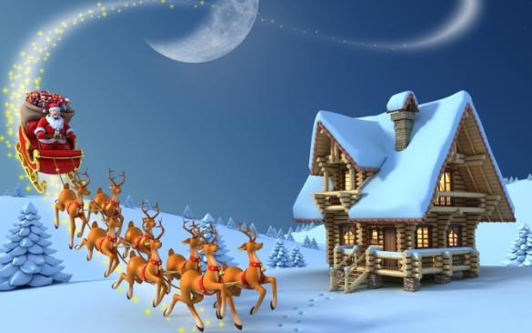
Give a brief description of the photos
1
(action,
location)
2

Slide 53
Say what the pictures
1
Have in common
2

Slide 54
Say in what way
1
the pictures are different
2

Slide 55
Say which of them (Santa Claus or Father Frost)
1
you like more
2

Slide 56
Explain why
1
2

Slide 57
HOW WELL DO YOU KNOW your class?

Slide 58
Your photo
When and where the photo was taken

Slide 59
Your photo
What/who is in the photo

Slide 60
Your photo
What is happening

Slide 61
Your photo
Why you keep the photo in your album

Slide 62
Your photo
Why you decided to show the photo to your friend

Slide 63
That’s all I wanted to tell you about these wonderful photos.

